Slide 1
UPPER SIXTH ARTS
GEOGRAPHY
Lesson 4
Modifications of Population Distribution
Notes:
Good morning, class, and welcome to our geography lesson. I am your geography teacher, Mr Kamdem. Today we are starting Lesson 4: Modifications of Population Distribution.

Slide 2
CLASS INFO
Class, Chapter and Duration
Class | Upper Sixth Arts
Chapter | Module 4: Understanding and managing population dynamics across the world in general and Cameroon in particular
Duration | 2 periods (2 × 50 minutes)
Notes:
This lesson is for Upper Sixth Arts. It belongs to Module 4: Understanding and managing population dynamics across the world in general and Cameroon in particular. We shall need 2 periods to cover it.

Slide 3
IDENTIFICATION
Lesson Identification
Topic | Population Numbers
Sub-topic | Population Density and Distribution
Lesson | Lesson 4: Modifications of Population Distribution
Notions / Concepts | Differential growth, replacement level, ageing, urbanisation, internal migration, international migration, push factor, pull factor, brain drain, remittances.
Syllabus focus | Effects of differential population growth rates on distribution (high growth, low growth, regional differences); migration as a factor of redistribution (internal and international).
Competence | Learners are able to explain how different growth rates and migration change the distribution of population and to propose solutions to the problems caused.
Notes:
Our topic is Population Numbers, and the sub-topic is Population Density and Distribution. The key notions we shall use today are: differential growth, replacement level, ageing, urbanisation, internal migration, international migration, push factor, pull factor, brain drain, remittances. At the end, you should be able to do this: learners are able to explain how different growth rates and migration change the distribution of population and to propose solutions to the problems caused.

Slide 4

HOMEWORK CORRECTION
Correction of the Homework
Question (Practical Work 2: Population Distribution and Altitude):
Name one push factor of rural-urban migration in Cameroon.
Notes:
Before we start the new lesson, let us correct the homework I gave you at the end of Practical Work 2: Population Distribution and Altitude. The question was: Name one push factor of rural-urban migration in Cameroon. Take out your exercise books.

Slide 5
HOMEWORK CORRECTION
Correction: Possible Answer
Lack of jobs, poor roads and services, poor harvests or insecurity in rural areas (any one).
Notes:
Here is a good answer. Lack of jobs, poor roads and services, poor harvests or insecurity in rural areas (any one). Compare it with your own answer and correct your work in red.

Slide 6
LESSON PLAN
Lesson Plan
Correction of the homework
Objectives and recall
Real-life situation and action to take
Learning activities
Board summary
Evaluation, remediation and homework
Notes:
Here is the plan of our lesson today. First, we shall correct the homework. Then we shall look at the objectives and recall what you already know. After that, we shall study a situation from real life and the action to take, and do the learning activities. Finally, we shall copy the board summary, do the evaluation and the remediation, and I will give you the homework.

Slide 7
OBJECTIVES
Objectives
By the end of this lesson, you should be able to:
Explain the effects of high population growth on distribution.
Explain the effects of low or declining growth.
Notes:
Take your time to copy this part; we will continue together.

Slide 8
OBJECTIVES
Objectives (continued)
Describe regional differences in growth within a country.
Explain how internal and international migration redistribute population.
Notes:
By the end of this lesson, you should be able to do four things. Number 1: explain the effects of high population growth on distribution. Number 2: explain the effects of low or declining growth. Number 3: describe regional differences in growth within a country. Number 4: explain how internal and international migration redistribute population.

Slide 9
PREVIOUS KNOWLEDGE
Previous Knowledge
People are attracted by jobs and services.
War pushes people out of an area.
Density is very uneven in Cameroon.
Notes:
Let us first remember what you already know. People are attracted by jobs and services. War pushes people out of an area. Density is very uneven in Cameroon. Keep this in mind, because we shall build on it today.

Slide 10
REAL-LIFE SITUATION
Situation in Real Life
In the village of Mayo-Oulo, many young men have left for Garoua, Douala and Yaoundé; only old people and children remain to cultivate the fields.
Notes:
Take your time to copy this part; we will continue together.

Slide 11
REAL-LIFE SITUATION
Situation in Real Life (continued)
At the same time, new neighbourhoods and informal settlements spread around Garoua, and some young people even try to reach Europe.
The village chief asks: "How do population growth and migration change where people live, and what are the consequences?"
Notes:
Listen carefully to this situation from real life. In the village of Mayo-Oulo, many young men have left for Garoua, Douala and Yaoundé; only old people and children remain to cultivate the fields. At the same time, new neighbourhoods and informal settlements spread around Garoua, and some young people even try to reach Europe. The village chief asks: "How do population growth and migration change where people live, and what are the consequences?" Think about it, because I am going to ask you some questions.

Slide 12
REAL-LIFE SITUATION
Situation: Question 1
What is the problem in the situation?
Notes:
Question 1: What is the problem in the situation? Think for a moment, then raise your hand to answer.

Slide 13
REAL-LIFE SITUATION
Answer
The chief does not understand how growth and migration change the distribution of people.
Notes:
Good. The chief does not understand how growth and migration change the distribution of people.

Slide 14
REAL-LIFE SITUATION
Situation: Question 2
Why do young men leave the village?
Notes:
Question 2: Why do young men leave the village? Think for a moment, then raise your hand to answer.

Slide 15
REAL-LIFE SITUATION
Answer
They look for jobs, schools and better living conditions in towns.
Notes:
Good. They look for jobs, schools and better living conditions in towns.

Slide 16
REAL-LIFE SITUATION
Situation: Question 3
What happens to Garoua?
Notes:
Question 3: What happens to Garoua? Think for a moment, then raise your hand to answer.

Slide 17
REAL-LIFE SITUATION
Possible Answer
It grows fast, with new neighbourhoods and informal settlements.
Notes:
Good. It grows fast, with new neighbourhoods and informal settlements.

Slide 18
ACTION TO TAKE
Action to Take
Support rural development (roads, schools, water) to reduce excessive rural exodus.
Notes:
From this situation, the action we are working towards in this lesson is the following: support rural development (roads, schools, water) to reduce excessive rural exodus.

Slide 19
JUSTIFICATION
Justification of the Lesson
This lesson helps us to understand why towns grow and villages empty, and to plan for these changes.
Notes:
Why is this lesson important for you? This lesson helps us to understand why towns grow and villages empty, and to plan for these changes.

Slide 20
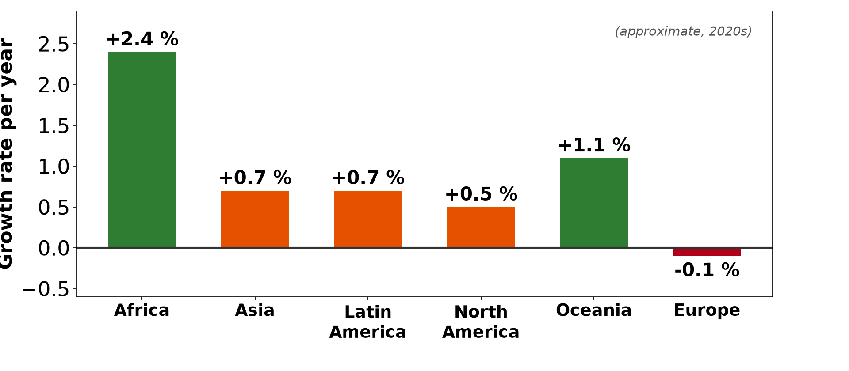
1. DIFFERENTIAL GROWTH
Activity 1
Growth rates by continent.
Notes:
Activity 1. Look carefully at this diagram: growth rates by continent. Observe every detail before I ask the question.

Slide 21
1. DIFFERENTIAL GROWTH
Activity 1: Question
Which continent has the highest growth rate?
Notes:
Here is the question for Activity 1: Which continent has the highest growth rate? Take one minute to think and write your answer in your rough notebook.

Slide 22
1. DIFFERENTIAL GROWTH
Activity 1: Answer
Africa (about 2.4 % per year).
Notes:
Let us check the answer together. Africa (about 2.4 % per year).

Slide 23
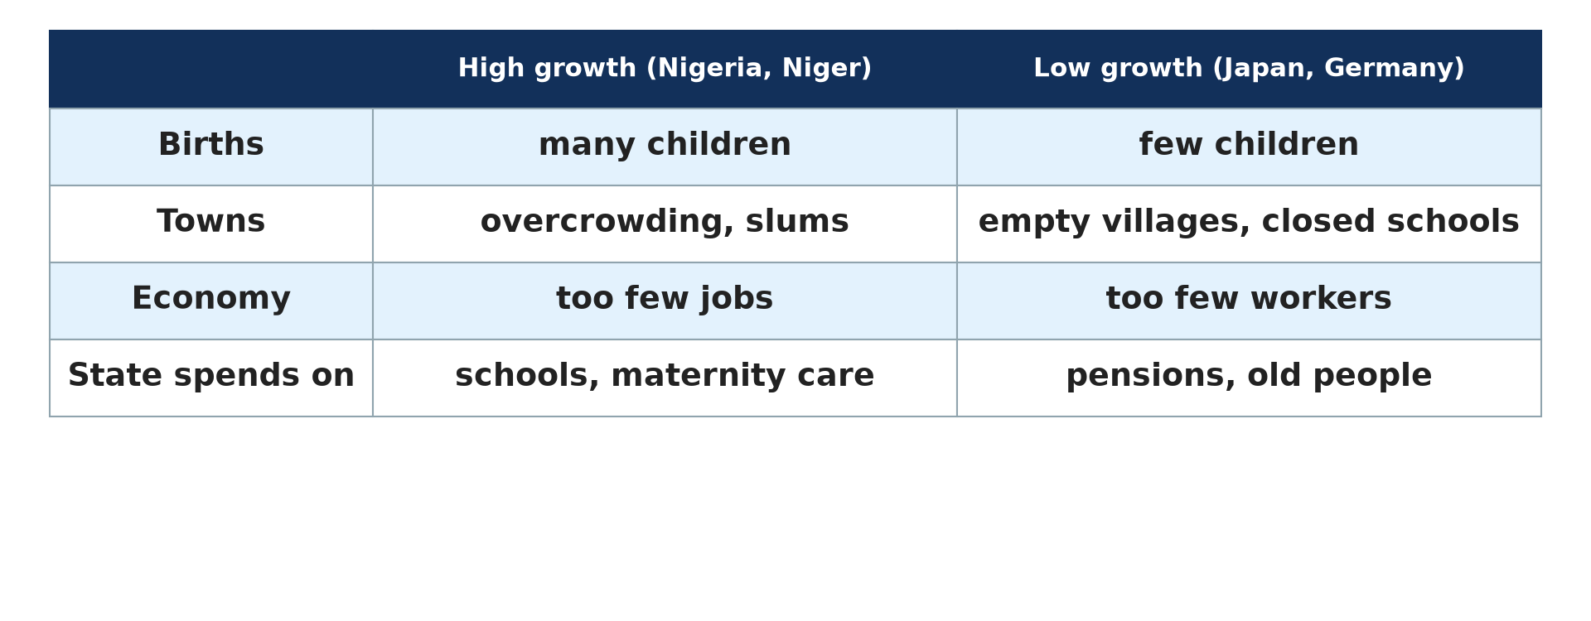
1. DIFFERENTIAL GROWTH
Activity 2
High growth and low growth.
Notes:
Activity 2. Look carefully at this picture: high growth and low growth. Observe every detail before I ask the question.

Slide 24
1. DIFFERENTIAL GROWTH
Activity 2: Question
Give one problem of a country with very low growth, like Japan.
Notes:
Here is the question for Activity 2: Give one problem of a country with very low growth, like Japan. Take one minute to think and write your answer in your rough notebook.

Slide 25
1. DIFFERENTIAL GROWTH
Activity 2: Answer
A shortage of workers or high spending on pensions.
Notes:
Let us check the answer together. A shortage of workers or high spending on pensions.

Slide 26
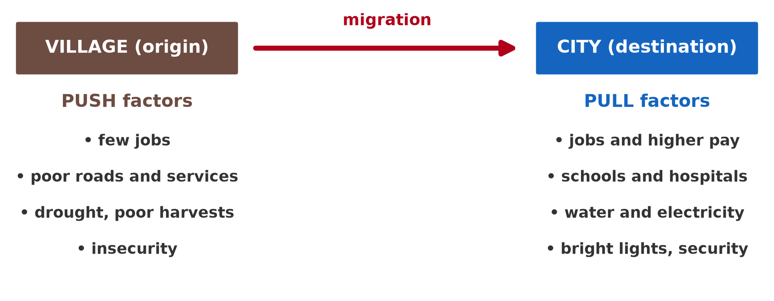
2. INTERNAL MIGRATION
Activity 3
Push and pull factors.
Notes:
Activity 3. Look carefully at this picture: push and pull factors. Observe every detail before I ask the question.

Slide 27
2. INTERNAL MIGRATION
Activity 3: Question
Give one pull factor of towns.
Notes:
Here is the question for Activity 3: Give one pull factor of towns. Take one minute to think and write your answer in your rough notebook.

Slide 28
2. INTERNAL MIGRATION
Activity 3: Answer
Jobs, schools, hospitals, water or electricity.
Notes:
Let us check the answer together. Jobs, schools, hospitals, water or electricity.

Slide 29

2. INTERNAL MIGRATION
Activity 4
An informal settlement.
Notes:
Activity 4. Look carefully at this picture: an informal settlement. Observe every detail before I ask the question.

Slide 30
2. INTERNAL MIGRATION
Activity 4: Question
Give one effect of rural exodus on towns.
Notes:
Here is the question for Activity 4: Give one effect of rural exodus on towns. Take one minute to think and write your answer in your rough notebook.

Slide 31
2. INTERNAL MIGRATION
Activity 4: Answer
Slums, unemployment, traffic jams and pressure on services.
Notes:
Let us check the answer together. Slums, unemployment, traffic jams and pressure on services.

Slide 32

3. INTERNATIONAL MIGRATION
Activity 5
Migrants at sea.
Notes:
Activity 5. Look carefully at this picture: migrants at sea. Observe every detail before I ask the question.

Slide 33
3. INTERNATIONAL MIGRATION
Activity 5: Question
What is the brain drain?
Notes:
Here is the question for Activity 5: What is the brain drain? Take one minute to think and write your answer in your rough notebook.

Slide 34
3. INTERNATIONAL MIGRATION
Activity 5: Answer
The emigration of skilled and educated people to richer countries.
Notes:
Let us check the answer together. The emigration of skilled and educated people to richer countries.

Slide 35
BOARD SUMMARY
Board Summary
Topic: Population Numbers
Sub-topic: Population Density and Distribution
Lesson 4: Modifications of Population Distribution
Notes:
Now we are going to copy the board summary. Write the title and the headings neatly in your notebooks. I will give you enough time for each slide, so do not rush.

Slide 36
BOARD SUMMARY
DEFINITIONS
The key terms of this lesson are defined as follows:
Differential growth: It is the difference in population growth rates between countries or regions.
Notes:
Let us copy the definitions. The key terms of this lesson are defined as follows. On this slide we have Differential growth. Write each point on a new line, with the key term first, and explain it in your own words when we revise. When you finish, we go to the next slide.

Slide 37
BOARD SUMMARY
DEFINITIONS (continued)
Replacement level: It is the fertility (about 2.1 children per woman) needed for a population to replace itself.
Push factor: It is a condition that forces people to leave a place.
Pull factor: It is a condition that attracts people to a place.
Notes:
We continue with the definitions. On this slide we have Replacement level, Push factor and Pull factor. Write each point on a new line, with the key term first, and explain it in your own words when we revise. When you finish, we go to the next slide.

Slide 38
BOARD SUMMARY
DEFINITIONS (continued)
Brain drain: It is the emigration of skilled and educated people.
Notes:
We continue with the definitions. On this slide we have Brain drain. Write each point on a new line, with the key term first, and explain it in your own words when we revise.

Slide 39
BOARD SUMMARY
1. Effects of Differential Population Growth Rates
A) High Growth Rates
High growth rates change the distribution of population in the following ways:
A growing share of the world population: Countries with high birth rates and falling death rates, such as Niger, Nigeria and Ethiopia, grow fast. Their share of the world population therefore increases.
Illustration: growth rates
Notes:
Let us copy High Growth Rates. High growth rates change the distribution of population in the following ways. Copy the point on A growing share of the world population on the left, then draw the diagram on the right: growth rates. Give it a title and label it clearly.

Slide 40
BOARD SUMMARY
1. Effects of Differential Population Growth Rates
A) High Growth Rates
Urban overcrowding: Much of the new population moves to towns, which grow very fast. Housing shortages and slums appear, and roads, water and schools are overloaded.
Illustration: a slum
Notes:
Copy the point on Urban overcrowding on the left, then draw the diagram on the right: a slum. Give it a title and label it clearly.

Slide 41
BOARD SUMMARY
1. Effects of Differential Population Growth Rates
A) High Growth Rates
Pressure on resources: The demand for food, water, land and health care becomes greater than what is available. People then move to new farming areas or to towns in search of resources.
Notes:
We continue with High Growth Rates. Copy the point on Pressure on resources: write the key term first, then its explanation.

Slide 42
BOARD SUMMARY
1. Effects of Differential Population Growth Rates
A) High Growth Rates
Damage to the environment: Forests are cleared to create new farms and settlements. Pollution and waste also increase in crowded areas.
Notes:
We continue with High Growth Rates. Copy the point on Damage to the environment: write the key term first, then its explanation.

Slide 43
BOARD SUMMARY
1. Effects of Differential Population Growth Rates
B) Low or Declining Growth Rates
Low or declining growth rates have the following effects:
A falling share of the world population: In Japan, Germany and Italy, fertility is below the replacement level and people live longer. These countries grow slowly or lose population, so their share of the world population decreases.
Illustration: effects of growth rates
Notes:
Let us copy Low or Declining Growth Rates. Low or declining growth rates have the following effects. Copy the point on A falling share of the world population on the left, then draw the diagram on the right: effects of growth rates. Give it a title and label it clearly.

Slide 44
BOARD SUMMARY
1. Effects of Differential Population Growth Rates
B) Low or Declining Growth Rates
A shrinking workforce: Fewer young people reach working age each year. Industries lack workers, which slows economic growth and attracts immigrants.
Notes:
We continue with Low or Declining Growth Rates. Copy the point on A shrinking workforce: write the key term first, then its explanation.

Slide 45
BOARD SUMMARY
1. Effects of Differential Population Growth Rates
B) Low or Declining Growth Rates
Heavy old-age dependency: A growing number of old people must be supported by fewer workers. Governments struggle to pay pensions and health care.
Notes:
We continue with Low or Declining Growth Rates. Copy the point on Heavy old-age dependency: write the key term first, then its explanation.

Slide 46
BOARD SUMMARY
1. Effects of Differential Population Growth Rates
B) Low or Declining Growth Rates
Empty villages: In rural areas, villages and schools close as young people leave and old people die. Population becomes concentrated in a few large towns.
Notes:
We continue with Low or Declining Growth Rates. Copy the point on Empty villages: write the key term first, then its explanation.

Slide 47
BOARD SUMMARY
1. Effects of Differential Population Growth Rates
C) Regional Differences within Countries
Growth differs between regions of the same country as follows:
Rural decline: Rural areas grow slowly or lose population as young people leave, as in many villages of the West and North of Cameroon. Labour shortages then reduce farm output and local development.
Notes:
Let us copy Regional Differences within Countries. Growth differs between regions of the same country as follows. Copy the point on Rural decline: write the key term first, then its explanation.

Slide 48

BOARD SUMMARY
1. Effects of Differential Population Growth Rates
C) Regional Differences within Countries
Urban growth: Towns such as Douala, Yaoundé and Garoua grow fast through natural increase and migration. They need more housing, transport, water and jobs.
Illustration: Douala
Notes:
Copy the point on Urban growth on the left, then draw the diagram on the right: douala. Give it a title and label it clearly.

Slide 49
BOARD SUMMARY
2. Migration as a Factor of Population Redistribution
A) Internal Migration
Internal migration redistributes population as follows:
Rural exodus: Internal migration is movement within a country, mostly from villages to towns, called rural exodus. It moves people from rural to urban areas and from poor to rich regions.
Illustration: push and pull factors
Notes:
Let us copy Internal Migration. Internal migration redistributes population as follows. Copy the point on Rural exodus on the left, then draw the diagram on the right: push and pull factors. Give it a title and label it clearly.

Slide 50

BOARD SUMMARY
2. Migration as a Factor of Population Redistribution
A) Internal Migration
Push factors in villages: Lack of jobs, poor roads and services, poor harvests and insecurity drive people out of villages. These areas therefore lose population.
Illustration: a moto-taxi
Notes:
Copy the point on Push factors in villages on the left, then draw the diagram on the right: a moto-taxi. Give it a title and label it clearly.

Slide 51
BOARD SUMMARY
2. Migration as a Factor of Population Redistribution
A) Internal Migration
Pull factors in towns: Towns attract migrants with jobs, better pay, schools, hospitals, water and electricity. Their population grows much faster than that of the countryside.
Notes:
We continue with Internal Migration. Copy the point on Pull factors in towns: write the key term first, then its explanation.

Slide 52

BOARD SUMMARY
2. Migration as a Factor of Population Redistribution
A) Internal Migration
Example of Cameroon: People move from the West, the North-West and the Far North to Douala and Yaoundé. The crises in the Far North, North-West and South-West have also pushed people towards safer towns.
Illustration: migrations in Cameroon
Notes:
Copy the point on Example of Cameroon on the left, then draw the diagram on the right: migrations in Cameroon. Give it a title and label it clearly.

Slide 53
BOARD SUMMARY
2. Migration as a Factor of Population Redistribution
B) Consequences of Internal Migration
Internal migration has the following consequences on distribution:
Rapid urban growth: Towns grow quickly as migrants arrive. Slums, traffic jams and unemployment appear because housing and jobs do not grow as fast.
Notes:
Let us copy Consequences of Internal Migration. Internal migration has the following consequences on distribution. Copy the point on Rapid urban growth: write the key term first, then its explanation.

Slide 54
BOARD SUMMARY
2. Migration as a Factor of Population Redistribution
B) Consequences of Internal Migration
Ageing villages: Villages lose their young workers and are left mainly with children and old people. Farm output falls because fewer people work the land.
Notes:
We continue with Consequences of Internal Migration. Copy the point on Ageing villages: write the key term first, then its explanation.

Slide 55
BOARD SUMMARY
2. Migration as a Factor of Population Redistribution
C) International Migration
International migration redistributes population as follows:
Movement between countries: International migration is movement from one country to another, for example from sub-Saharan Africa to Europe or North America. It increases the population of receiving countries and reduces that of sending countries.
Illustration: migrants at sea
Notes:
Let us copy International Migration. International migration redistributes population as follows. Copy the point on Movement between countries on the left, then draw the diagram on the right: migrants at sea. Give it a title and label it clearly.

Slide 56
BOARD SUMMARY
2. Migration as a Factor of Population Redistribution
C) International Migration
Push factors: War, poverty, unemployment and environmental problems force people to leave their countries. The populations of Syria and of many Sahel countries have been reduced in this way.
Notes:
We continue with International Migration. Copy the point on Push factors: write the key term first, then its explanation.

Slide 57
BOARD SUMMARY
2. Migration as a Factor of Population Redistribution
C) International Migration
Pull factors: Stable economies, higher wages and better living conditions attract migrants. The USA, Canada and Western Europe therefore receive large numbers of people.
Notes:
We continue with International Migration. Copy the point on Pull factors: write the key term first, then its explanation.

Slide 58
BOARD SUMMARY
2. Migration as a Factor of Population Redistribution
D) Effects of International Migration
International migration has the following effects:
Labour for host countries: Migrants fill labour shortages in farms, building sites, hospitals and services. They contribute to the economic growth of the host countries.
Notes:
Let us copy Effects of International Migration. International migration has the following effects. Copy the point on Labour for host countries: write the key term first, then its explanation.

Slide 59
BOARD SUMMARY
2. Migration as a Factor of Population Redistribution
D) Effects of International Migration
Pressure in host countries: Large arrivals may put pressure on housing, schools and health services. They can also cause social tensions with the local population.
Notes:
We continue with Effects of International Migration. Copy the point on Pressure in host countries: write the key term first, then its explanation.

Slide 60
BOARD SUMMARY
2. Migration as a Factor of Population Redistribution
D) Effects of International Migration
Brain drain: Countries of origin lose doctors, engineers and teachers who leave for better pay. This weakens their health and education services.
Notes:
We continue with Effects of International Migration. Copy the point on Brain drain: write the key term first, then its explanation.

Slide 61
BOARD SUMMARY
2. Migration as a Factor of Population Redistribution
D) Effects of International Migration
Remittances: Migrants send money home to their families. These remittances pay for food, school fees, houses and small businesses in the countries of origin.
Notes:
We continue with Effects of International Migration. Copy the point on Remittances: write the key term first, then its explanation.

Slide 62
FORMATIVE EVALUATION
Evaluation 1
Give two effects of rapid population growth on towns.
Notes:
Now let us check what you have understood. Question 1: Give two effects of rapid population growth on towns. Answer in your exercise book.

Slide 63
FORMATIVE EVALUATION
Expected Answer
Housing shortages and slums, unemployment, pressure on water, schools and transport (any two).
Notes:
The expected answer is: housing shortages and slums, unemployment, pressure on water, schools and transport (any two). If you got it right, well done.

Slide 64
FORMATIVE EVALUATION
Evaluation 2
Give one advantage and one disadvantage of international migration for the country of origin.
Notes:
Now let us check what you have understood. Question 2: Give one advantage and one disadvantage of international migration for the country of origin. Answer in your exercise book.

Slide 65
FORMATIVE EVALUATION
Expected Answer
Advantage: remittances; disadvantage: loss of skilled workers (brain drain).
Notes:
The expected answer is: advantage: remittances; disadvantage: loss of skilled workers (brain drain). If you got it right, well done.

Slide 66
REMEDIATION
Remediation
Fill in the blanks:
The movement of people from villages to towns is called rural ______.
Lack of jobs in villages is a ______ factor.
Notes:
Take your time to copy this part; we will continue together.

Slide 67
REMEDIATION
Remediation (continued)
Money sent home by migrants is called ______.
Notes:
For those who need more practice, fill in the blanks in your exercise book. The answers are: number 1, exodus; number 2, push; number 3, remittances.

Slide 68
HOMEWORK
Homework
List the three main age groups of a population.
Notes:
For your homework: List the three main age groups of a population. We shall correct it at the beginning of our next lesson.

Slide 69
NEXT LESSON
Next Lesson
Our next lesson will be on:
Lesson 5: Population Structure
Notes:
Our next lesson will be on Lesson 5: Population Structure. Thank you for your attention, and see you next time.

Slide 70
BILINGUAL GAME
Bilingual Game (Jeu Bilingue)
English | Français
Rural exodus | L'exode rural
Push factor | Le facteur répulsif
Pull factor | Le facteur attractif
Brain drain | La fuite des cerveaux
Remittances | Les transferts de fonds
Slum | Le bidonville
Notes:
Let us play the bilingual game. I say a word in English, and you give me the French word. Then we do the reverse.

Slide 71
LOGBOOK
Official Logbook (1/2)
Module / Topic | Population Numbers
Lesson Title | Lesson 4: Modifications of Population Distribution
Expected Learning Outcomes | Explain the effects of high population growth on distribution. Explain the effects of low or declining growth. Describe regional differences in growth within a country. Explain how internal and international migration redistribute population.
Competence | Learners are able to explain how different growth rates and migration change the distribution of population and to propose solutions to the problems caused.
Notes:
I record this information in the official logbook of the class after the lesson.

Slide 72
LOGBOOK
Official Logbook (2/2)
Matter Taught | DEFINITIONS; High Growth Rates; Low or Declining Growth Rates; Regional Differences within Countries; Internal Migration; Consequences of Internal Migration; International Migration; Effects of International Migration.
Evaluation | Formative evaluation and remediation exercise.
Homework | List the three main age groups of a population.
Enrolment / Present / Absent | ____ / ____ / ____
Achievement | To be completed after the lesson.
Notes:
I complete the second page of the logbook: the matter taught, the evaluation, the homework and the attendance.

Slide 73
TEACHER'S NOTE
Teacher's Note
Timing: Homework correction, plan, objectives 8 min | Recall, situation, action 10 min | 5 activities 30 min | Board summary (copying) 30 min | Evaluation, remediation 10 min | Homework, next lesson 5 min | Logbook 7 min
Without the projector (Activity 1): write the growth rates on the board.
Without the projector (Activity 2): compare Niger and Japan.
Without the projector (Activity 3): draw the two columns.
Without the projector (Activity 4): describe a crowded neighbourhood.
Without the projector (Activity 5): talk about doctors who work abroad.
Notes:
This slide is for me, the teacher: it gives the timing of the lesson and what to do if the projector is not available.

Slide 74
REFERENCES
References
Geography Syllabus for Sixth Forms (Lower and Upper Sixth), MINESEC, 2019 — Module 4 (Population Geography).
Teacher's course notes: Mr KAMDEM E., Population Geography (USA), GBHS Garoua, 2026.
United Nations, World Population Prospects 2024.
Photo, Activity 4: “Mathare” by Book Aid International, CC BY-NC-ND 2.0, via Flickr (https://www.flickr.com/photos/45024905@N07/4135561707)
Photo, Activity 5: “A sailor from HMS BULWARK hands out water to rescued individuals on a ” by Royal Navy Media Archive, CC BY-NC 2.0, via Flickr (https://www.flickr.com/photos/69974959@N03/17374754690)
Photo, board summary (Urban growth): “Douala” by christing-O-, CC BY 2.0, via Flickr (https://www.flickr.com/photos/76187282@N00/7227535754)
Photo, board summary (Push factors in villages): “Cameroon - UN Women's Gender Road Project” by UN Women Gallery, CC BY-NC-ND 2.0, via Flickr (https://www.flickr.com/photos/51431730@N04/47586053052)
Notes:
Take your time to copy this part; we will continue together.

Slide 75
REFERENCES
References (continued)
Diagrams and animations: drawn for this lesson (Geography Department).
Notes:
These are the references and picture credits used to prepare this lesson.

